Slide 1
To start learning RFT
Niklas Törneke

Slide 2
The structure of the presentation
Basic assumptions: Functional contextualism
Basic understanding of relational frame theory
General and clinical implications

Slide 3
Functional contextualism
How is the phenomena of thinking dealt with, starting
from these assumptions?
CONTEXT
Thinking is behavior which is subtle or private and thus
hard to observe, except for the person doing it (and sometimes even…)
Thinking is dependent on language (verbal behavior)
Thinking can be understood using the same basic
behavioral principles as for understanding other behavior
Thinking can effect other behavior of the same organism as
in other behavior–behavior interaction
CONTEXT

Slide 4
Respondent
Unconditioned stimulus (US) Unconditioned response (UR)
Conditioned stimulus (CS) Conditioned response (CR)
Operant
Antecedent Behavior
Consequence

Slide 5
RFT; one central idea
Human languaging and cognition consists of a specific kind of learned behavior:
A particular way of relating stimuli

Slide 6
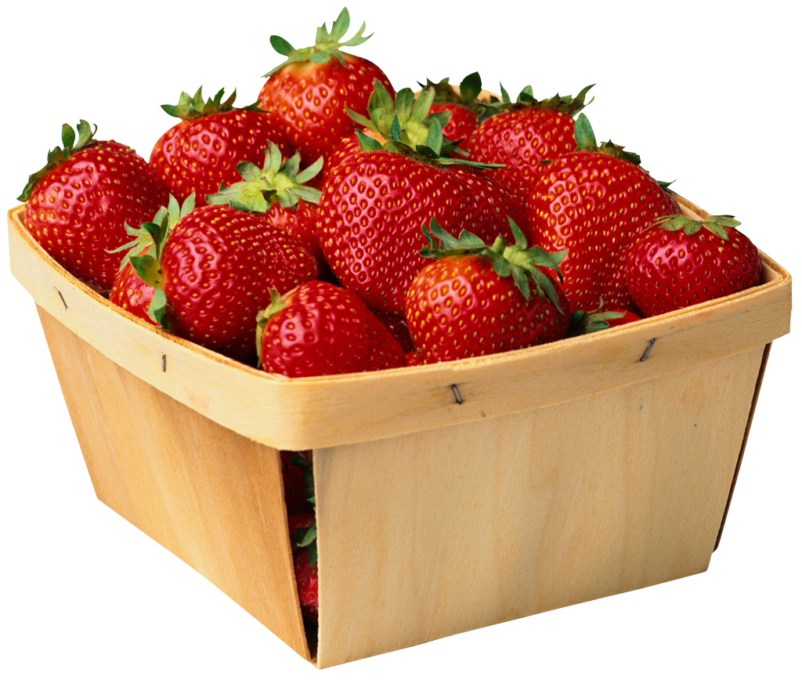
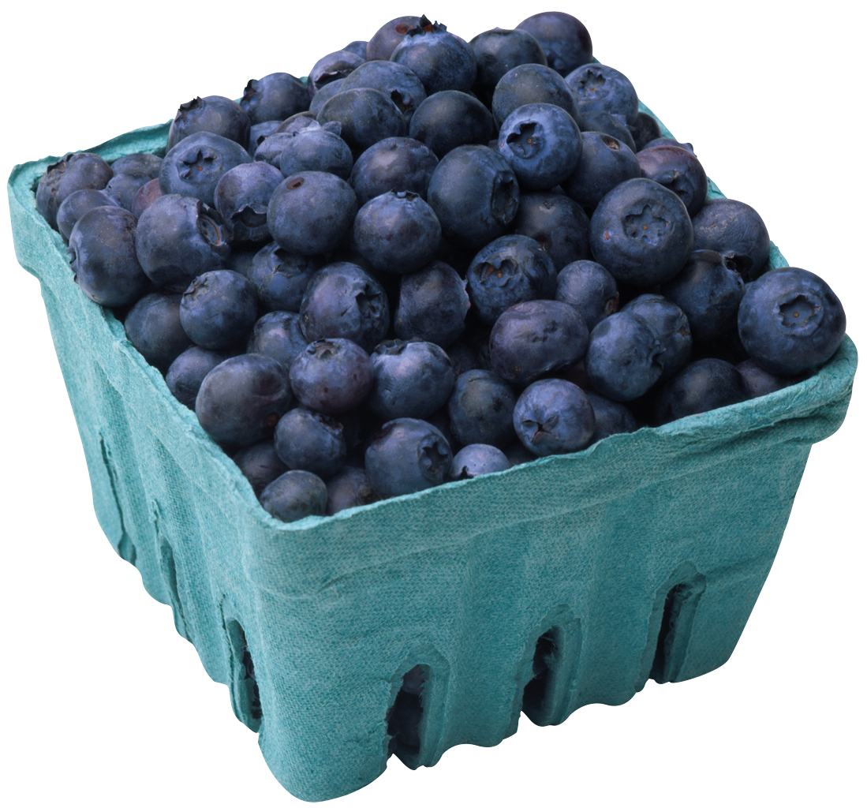
Relating controlled by the phenomena related

Slide 7
Relating controlled by arbitrary contextual cues
Humans teach their offspring to abstract arbitrary stimuli (sounds, words, gestures) to controll relations and thereby alter stimulus function
is more than
is less than
is the same as 10000 dollars
is the same as a hard punch on the nose

Slide 8
Relating controlled by arbitrary contextual cues
LESS THAN
MORE THAN

Slide 9
Different relations
This particular kind of relating is called:
Arbitrarily applicable relational responding
Derived relational responding
Relational framing
AFTER
IN FRONT OF
LESS THAN
MORE THAN
BEFORE
BEHIND

Slide 10
An exercise
In what way is…
One list Another list
1. 1. behind 1. ?
2. 2. longer than 2. ?
3. 3. before 3. ?
4. 4. better than 4 ?.
5. 5. inside 5. ?
6. 6. same as 6. ?
7. 7. part of 7. ?

Slide 11
The effects of relational framing
For a human being anything in the context can obtain functions due to social whim
The very behavior of humans (even private, subtle behavior) can obtain functions due to social whim
The technical term for this is transformation of functions
Two areas of special importance: The ability to follow instructions (rule following) Interaction with your own behavior (self)

Slide 12
Rule following
All is changed when stimuli (part of the context)
can acquire function (effect on behavior) in a new way!
“Turn left at the next traffic light, drive one kilometer and take first right
after the petrol station and then you will see the football arena straight ahead”
“Make sure you sleep, otherwise you will be ill”
“If you go to bed now you will have a surprise tomorrow”
“If you do that again I will go away and never come back”
“Find out why you are anxious and the anxiety will go away”
CONTEXT
A
B
C
CONTEXT

Slide 13
Interacting with your own behavior
CONTEXT
CONTEXT

Slide 14
Interacting with your own behavior (self)
Training in verbal self–discrimination
In simple words:
I learn that I am “I” and that my own subtle responses, such as thinking and feeling, are part of but not identical to “I”
Training in deictic framing of your own responses
I – HERE – NOW versus I – THERE – THEN
As a result we have the “fromeness” of human experience: a particular experience of perspective which is a result of the ability to interact with arbitrary contextual cues (we experience a “deictic I”)
Self as ongoing process
Self as story, content or concept
Self as perspective or context
In technical words:
I learn to frame my own responses in perspective from and in hierarchy with the deictic I

Slide 15
Interacting with your own behavior (self)
Training verbal self–discrimination
Self as ongoing process
Self as concept, content or story
Self as perspective or context
In simple words:
I learn that I am “I” and that my own subtle responses, such as thinking and feeling, are part of but not identical to “I”
In technical words:
I learn to frame my own responses in perspective from and in hierarchy with the deictic I

Slide 16
Behavior – behavior interaction
Functioning as antecedents; self–rules
Functioning as consequences
“What I should not have done”
“What I will do better”
“The cause of what happened”
“The thing which has to be taken away”

Slide 17
The risks of relational framing
To sum it up:
Your own verbal behavior can trick
you into doing things that will not
work well for you!
The interface with pain will increase enormously
Following instructions: direct experience can be overruled
Sensibility to social whim is built in
The risk of getting stuck in vicious circles when following instructions

Slide 18
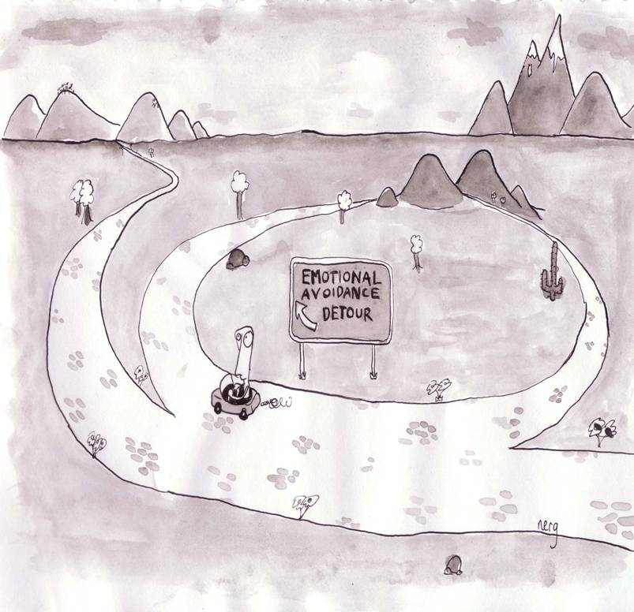
Flexibility
Psychological treatment informed
by relational frame theory:
ACT
Rigidity

Slide 19
Flexibility:
Psychological flexibility is the ability to notice and react to your
thoughts, feelings, and behaviour in order to give one the
opportunity to take action towards important ends.
More specifically this involves responding to one's own responding
as participating in a frame of hierarchy with the deictic “I.” This is
typically accompanied by a substantial reduction in the behavioural
control functions of the response in question, which thereby allows
for additional relational responding that specifies appetitive
augmental functions, and further behaviour that is coordinated
with that relational responding

Slide 20
Rigidity:
Fusion
Experiential avoidance
Fusion: Not distinguishing, in the moment, “I” from subtle/private self–instructions (your own responses)
Experiential avoidance: Following of self–instructions to control, extinguish or lessen private responses such as feelings, thoughts, memories and bodily sensations

Slide 21
Three clinical tasks
Help the client discriminate the relationship between current functional classes of behaviour and problematic consequences. According to the analysis done we expect the problematic functional class to be responding in coordination with self-instructions/rules.
Help the client discriminate his/her own responses and frame them in perspective and hierarchy with the deictic I and train this repertoire as an alternative functional class.
Help the client specify appetitive augmental functions for further behaviour

Slide 22
C
B
B
A
C
Notes:
”

Slide 23
Tools for therapy
Functional analysis is at the root of ACT
Metaphor
Experiential excercises

